Slide 1
Lab Farm
Sam Van Bogaert | Seppe De Beule | Kevin Van de Vyver | Inias Somers Raymond Mohammad | Melvin Bootsgezel

Slide 2
Marktonderzoek
Smart Object | Technologieën
Smart Pot | Self-watering, App dashboard
Planty | Self-watering via internet
Edyn garden sensor kit | Tracks light, temperature, humidity …
SPOT | Self-watering, takes pictures
Aquaponics system | Uses pumps & hydraulica
Gardena Micro-Drip System | Self-watering

Slide 3
Inventarisatie Software
Angular 6 & Node.js
Python
Microsoft Azure

Slide 4
Inventarisatie Hardware
DHT22 – Temperatuur & luchtvochtigheid sensor
SEN-13637 – Bodemvochtigheid sensor
SEN-11050 – Temperatuur sensor (waterproof)
SEN-10972 – pH sensor
APDS-9301 – Licht sensor
SEN-0204 – Water niveau sensor
Raspberry Pi 3
PCB
Kunststof water magneetventiel – 12V
SLV Transformer 60W 12V

Slide 5
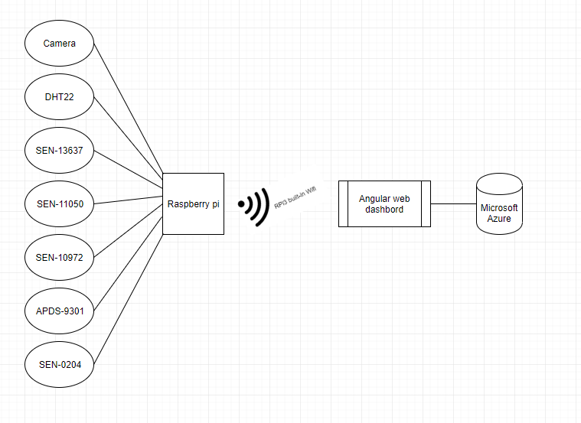
Algemene architectuur

Slide 6
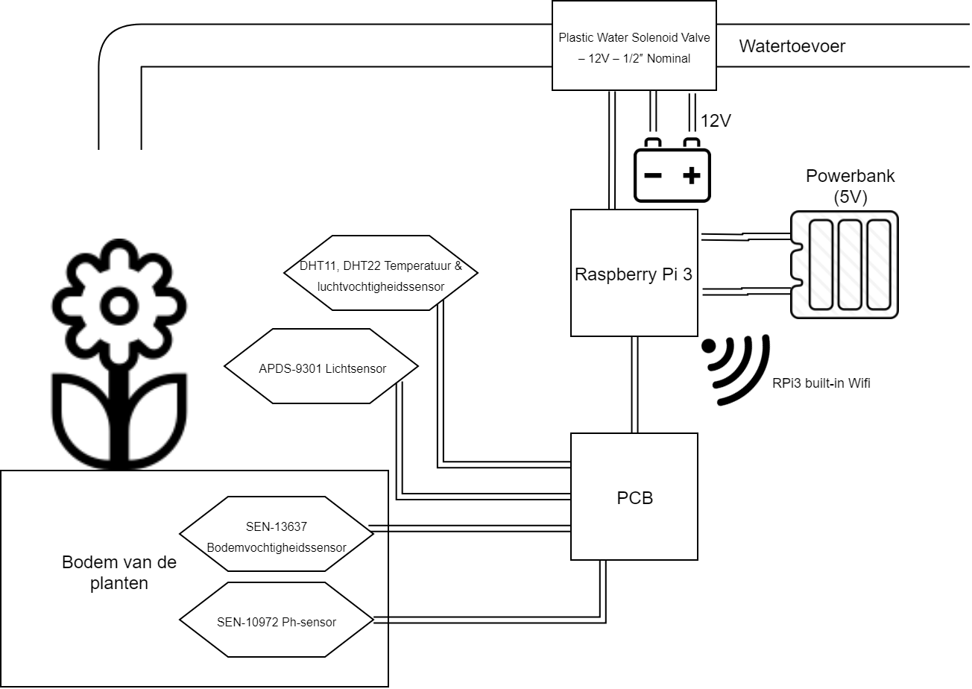
Hardware diagram

Slide 7
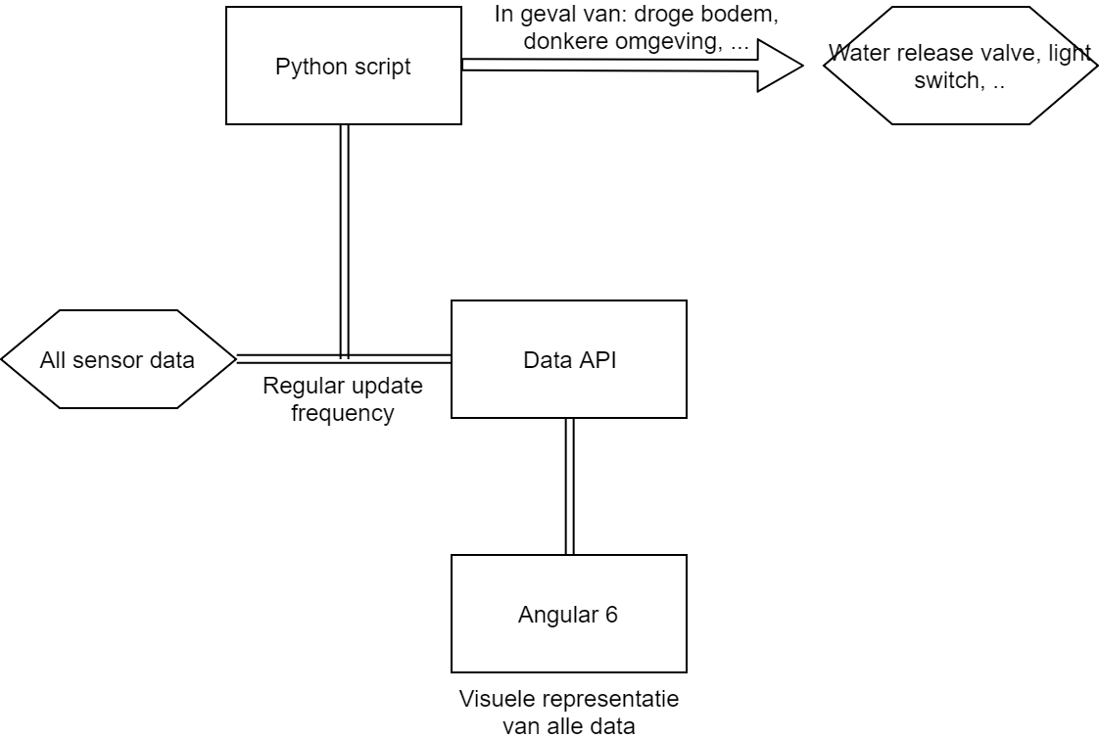
Software diagram

Slide 8
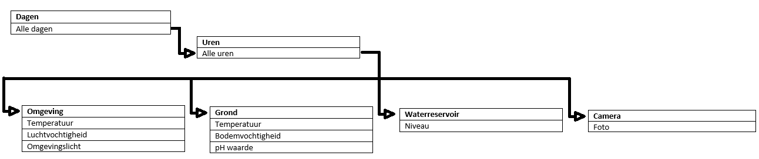
Relationele databank diagram

